Slide 1
What’s In A Word? (II)
Lecture 3: Optimization, Evaluation, and Bias in Word Vectors

Slide 3
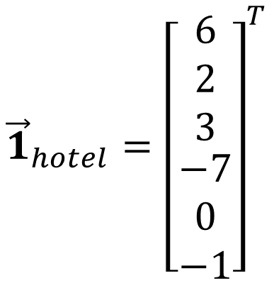
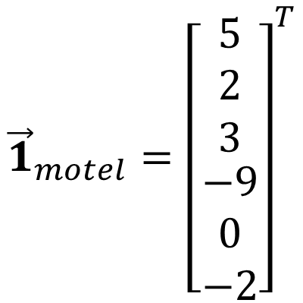
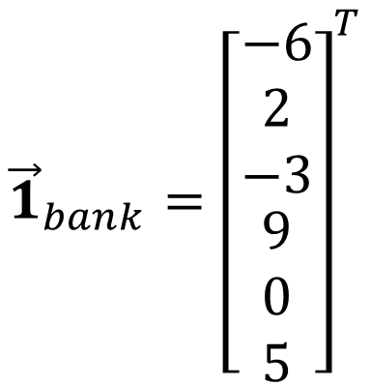
Word Vectors
Idea: Learn a continuous vector for each word that captures things like similarity between words.
$${\vec{1}}_{motel}={\left[\begin{matrix}\begin{matrix}5 \\ 2 \\ 3\end{matrix} \\ \begin{matrix}−9 \\ 0 \\ −2\end{matrix}\end{matrix}\right]}^{T}$$
$${\vec{1}}_{hotel}={\left[\begin{matrix}\begin{matrix}6 \\ 2 \\ 3\end{matrix} \\ \begin{matrix}−7 \\ 0 \\ −1\end{matrix}\end{matrix}\right]}^{T}$$
$${\vec{1}}_{bank}={\left[\begin{matrix}\begin{matrix}−6 \\ 2 \\ −3\end{matrix} \\ \begin{matrix}9 \\ 0 \\ 5\end{matrix}\end{matrix}\right]}^{T}$$
$${d(\vec{1}}_{motel},{\vec{1}}_{hotel})<{d(\vec{1}}_{motel},{\vec{1}}_{bank})$$

Slide 4

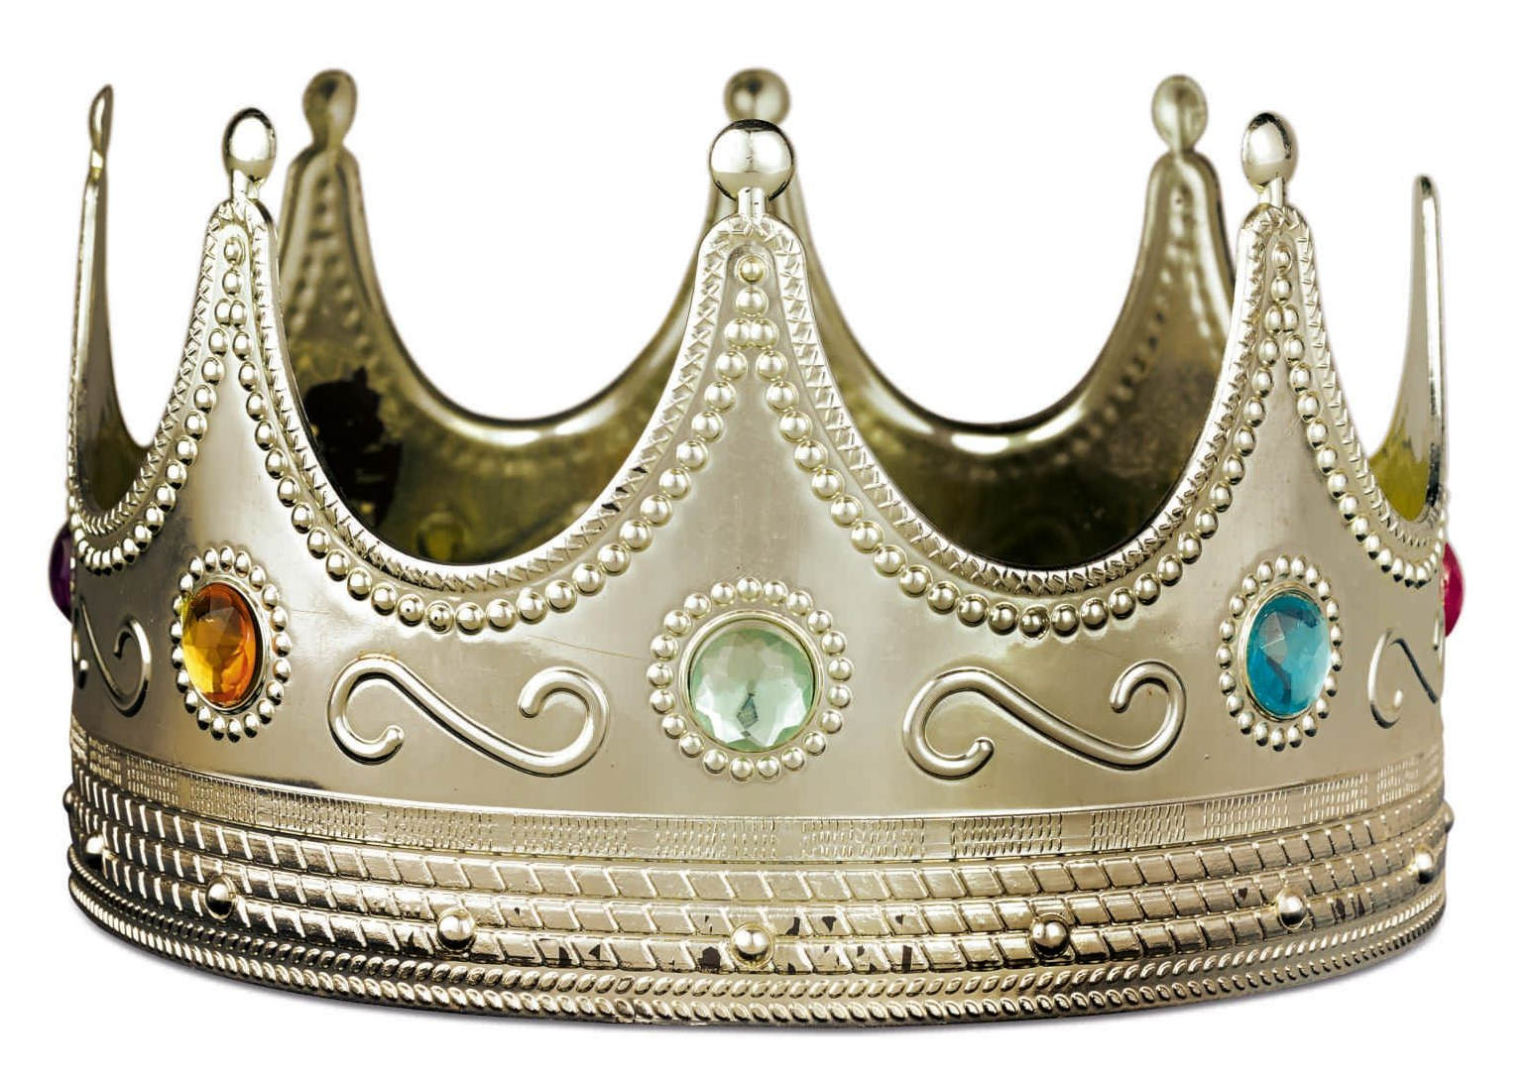
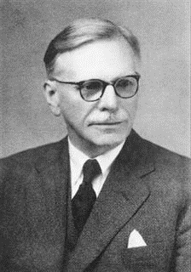
The Distributional Hypothesis of Meaning
"You shall know a word by the company it keeps!”
- John Firth in A Synopsis of Linguistic Theory p11 -- 1957
One of the most successful ideas in modern statistical NLP

Slide 5
Distributed Word Vector Ideas
How to apply the Distributional Hypothesis computational?
Idea 1: Represent words as vectors of co-occurrence with other words in a corpus of text. → Frequency-based word vectors
Idea 2: Assume a model of word co-occurrence that depends on word vectors. Then learn word vectors to maximize the likelihood of the model on a corpus of text. → Learning-based word vectors

Slide 6
Word2Vec Model Assumption
Word2Vec Assumption: The probability of observing a word in the context of another word depends only on the relationship between their word vectors
center word
The roots of education are bitter but the fruit is sweet.
P(the | bitter)
P(education | bitter)
P(are | bitter)
P(but | bitter)
Efficient Estimation of Word Representations in Vector Space (https://arxiv.org/pdf/1301.3781.pdf)

Slide 7
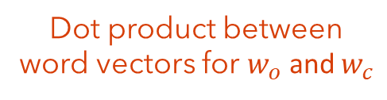
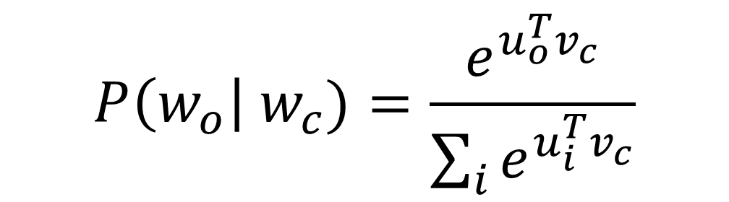
Word2Vec Model Assumption
Word2Vec Assumption: The probability of observing a word in the context of another word depends only on the relationship between their word vectors
Let each word $i$ be represented by d-dimensional vectors $u_{i}$ and $v_{i}, then define:$
Dot product between word vectors for $w_{o}$ and $w_{c}$
$$P\left(w_{o}\right| w_{c})=\frac{e^{u_{o}^{T}v_{c}}}{\sum_{i}{e^{u_{i}^{T}v_{c}}}}$$
Normalizing constant over whole vocabulary
Efficient Estimation of Word Representations in Vector Space (https://arxiv.org/pdf/1301.3781.pdf)

Slide 8
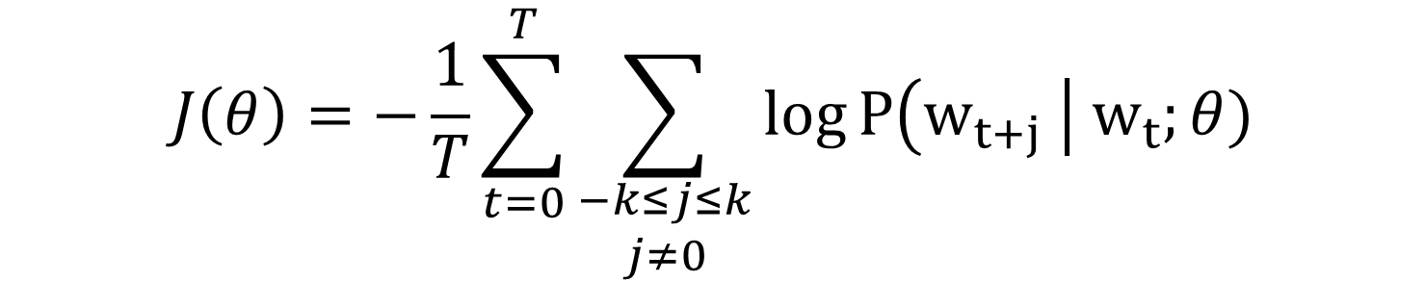
Word2Vec Model Objective
Objective: Maximizing likelihood same as minimizing negative log likelihood
At each position t in the text
compute probability of observing the word given the center
$$J\left(θ\right)=−\frac{1}{T}\sum_{t=0}^{T}{\sum_{\begin{aligned}−k≤j≤k \\ j≠0\end{aligned}}{log}}P\left(w_{t+j} \right| w_{t};θ)$$
for every word in the window centered at t
How to minimize this objective with respect to $θ$?

Slide 9
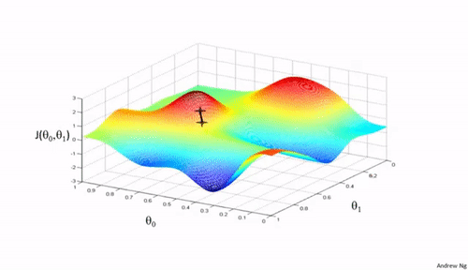
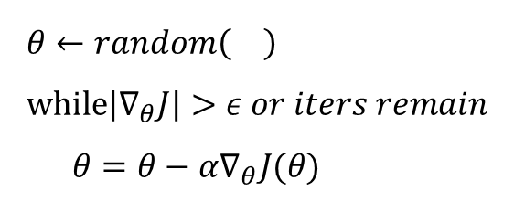
Gradient Descent
Recall from Machine Learning / Calculus / Optimization
Our objective is a function $J:θ→ ℝ^{+}$, think of it as “loss surface”. Optimization is about getting as low as possible on this surface.
Recall: Gradient (vector of partial derivatives) point in the direction of steepest ascent.
Gradient Descent Algorithm
$$θ←random\left(\right) \\ while\left|∇_{θ}J\right|>ε or iters remain \\ θ=θ−α∇_{θ}J(θ)$$
Learning Rate / Step Size

Slide 10
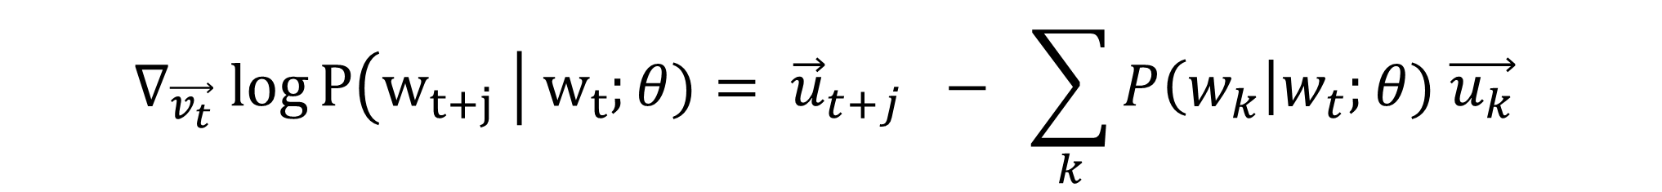
Derivation for $∇_{v_{t}}log⁡P\left(w_{t+j} \right| w_{t};θ)$ on screen.
Vector of context word
$$∇_{\vec{v_{t}}} log⁡P\left(w_{t+j} \right| w_{t};θ)= {\vec{u}}_{t+j} − \sum_{k}{P\left(w_{k}\right|w_{t};θ) \vec{u_{k}} }$$
Expected prediction

Slide 11
Be able to answer:
How is word2vec optimized?
What is Stochastic Gradient Descent?
Why is the word2vec objective inefficient and how can this shortcoming be mitigated?
How are word vectors evaluated?
Describe intrinsic vs extrinsic evaluation in NLP
What are the dangers of learning from historic data and large corpuses?

Slide 12
Word2Vec Training Algorithm (Gradient Descent)
Initialize word vectors $θ=[ v_{0};…;v_{\left|V\right|};u_{0};…;u_{\left|V\right|}]$ randomly
While iters < maxIters:
Compute $∇_{θ}J\left(D;θ\right)=−\frac{1}{|D|}\sum_{t=0}^{|D|}{\sum_{\begin{aligned}−k≤j≤k \\ j≠0\end{aligned}}{∇_{θ} log⁡P\left(w_{t+j} \right| w_{t};θ)}}$
Update $θ←θ−α∇_{θ}J\left(D;θ\right)$
Problem 1: Gradient descent requires iterating over whole corpus -- slow to converge and expensive

Slide 13
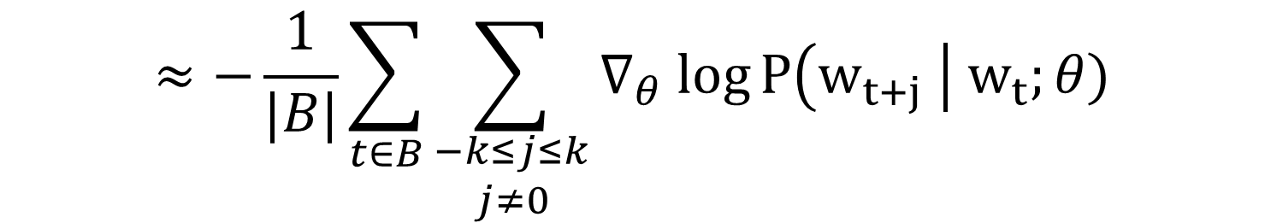
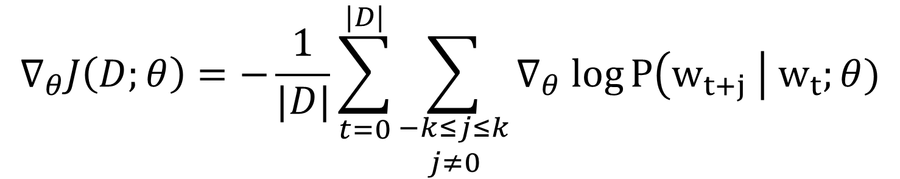
Stochastic Gradient Descent (SGD)
$$∇_{θ}J\left(D;θ\right)=−\frac{1}{|D|}\sum_{t=0}^{|D|}{\sum_{\begin{aligned}−k≤j≤k \\ j≠0\end{aligned}}{∇_{θ} log⁡P\left(w_{t+j} \right| w_{t};θ)}}$$
$$≈−\frac{1}{|B|}\sum_{t∈B}{\sum_{\begin{aligned}−k≤j≤k \\ j≠0\end{aligned}}{∇_{θ} log⁡P\left(w_{t+j} \right| w_{t};θ)}}$$
SGD: Approximate full gradient with a small, random subset of instances (called a batch) for each parameter update step

Slide 14
Word2Vec Training Algorithm (Stochastic Gradient Descent)
Initialize word vectors $θ=[ v_{0};…;v_{\left|V\right|};u_{0};…;u_{\left|V\right|}]$ randomly
While iters < maxIters:
Sample batch $B∼D$
Compute $∇_{θ}J\left(B;θ\right)=−\frac{1}{|B|}\sum_{t∈B}{\sum_{\begin{aligned}−k≤j≤k \\ j≠0\end{aligned}}{∇_{θ} log⁡P\left(w_{t+j} \right| w_{t};θ)}}$
Update $θ←θ−α∇_{θ}J\left(B;θ\right)$
SGD: Takes $O\left(\left|B\right|k\right)$ computations of $P\left(w_{t+j} \right| w_{t};θ)$per step

Slide 15
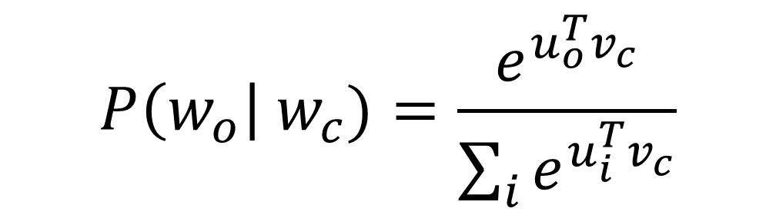
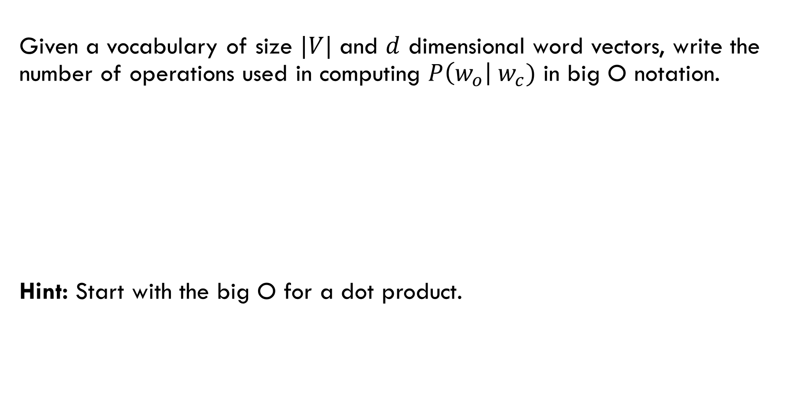
Given a vocabulary of size $|V|$ and $d$ dimensional word vectors, write the number of operations used in computing $P\left(w_{o}\right| w_{c})$ in big O notation.
Hint: Start with the big O for a dot product.
$$P\left(w_{o}\right| w_{c})=\frac{e^{u_{o}^{T}v_{c}}}{\sum_{i}{e^{u_{i}^{T}v_{c}}}}$$

Slide 16
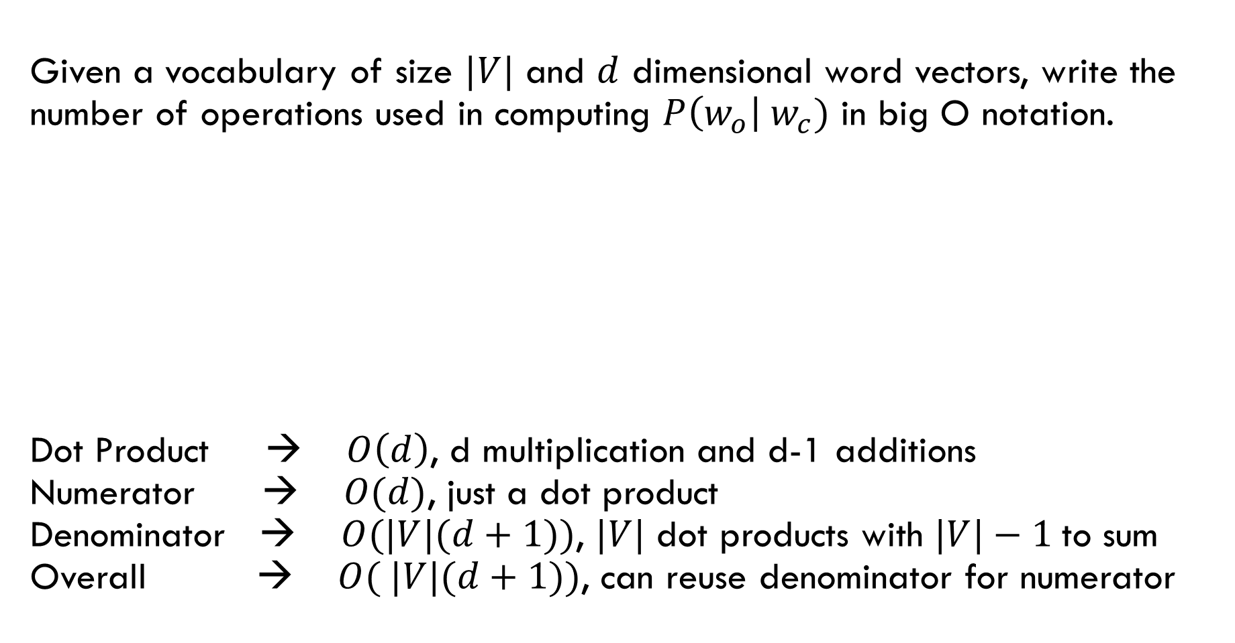
Given a vocabulary of size $|V|$ and $d$ dimensional word vectors, write the number of operations used in computing $P\left(w_{o}\right| w_{c})$ in big O notation.
Dot Product → $O\left(d\right)$, d multiplication and d-1 additions Numerator → $O(d)$, just a dot product Denominator → $O(|V|(d+1))$, $|V|$ dot products with $|V|−1$to sum Overall → $O( |V|(d+1))$, can reuse denominator for numerator
$$P\left(w_{o}\right| w_{c})=\frac{e^{u_{o}^{T}v_{c}}}{\sum_{i}{e^{u_{i}^{T}v_{c}}}}$$

Slide 17
Word2Vec Training Algorithm (Stochastic Gradient Descent)
Initialize word vectors $θ=[ v_{0};…;v_{\left|V\right|};u_{0};…;u_{\left|V\right|}]$ randomly
While iters < maxIters:
Sample batch $B∼D$
Compute $∇_{θ}J\left(B;θ\right)=−\frac{1}{|B|}\sum_{t∈B}{\sum_{\begin{aligned}−k≤j≤k \\ j≠0\end{aligned}}{∇_{θ} log⁡P\left(w_{t+j} \right| w_{t};θ)}}$
Update $θ←θ−α∇_{θ}J\left(B;θ\right)$
Problem 2: Takes $O\left(\left|B\right|\left|V\right|\left(d+1\right)+\left|B\right|k\right)$ ops per update step (assumes heavy re-use of dot products)

Slide 18
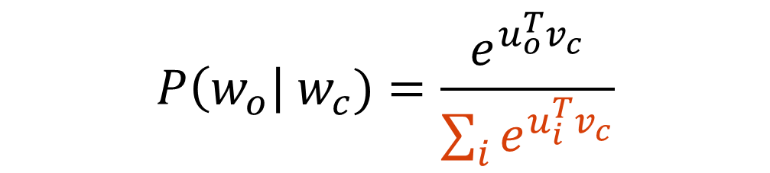
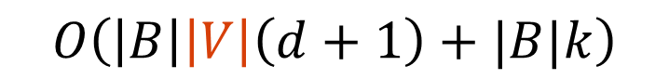
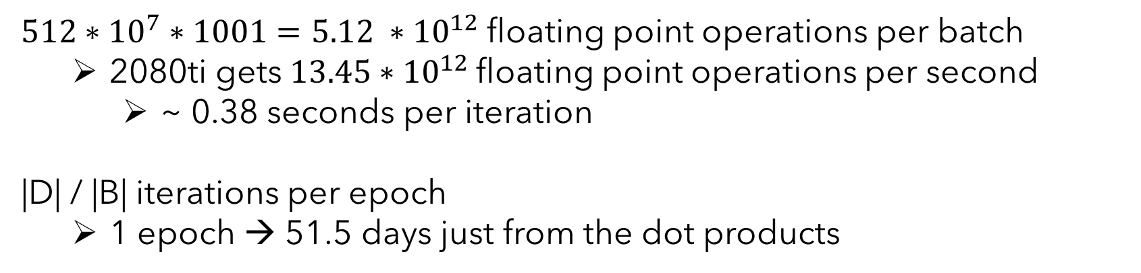
Time Per Epoch Naïve Word2Vec
$O\left(\left|B\right|\left|V\right|\left(d+1\right)+|B|k\right)$ operations per batch
Common to see $B=512, \left|V\right|={10}^{7}, d=1000, k=10, and \left|D\right|=6,000,000,000$
Google News 6B
$512∗{10}^{7}∗1001=5.12 ∗{10}^{12}$ floating point operations per batch
2080ti gets $13.45∗{10}^{12}$floating point operations per second
~ 0.38 seconds per iteration
|D| / |B| iterations per epoch
1 epoch → 51.5 days just from the dot products
$$P\left(w_{o}\right| w_{c})=\frac{e^{u_{o}^{T}v_{c}}}{\sum_{i}{e^{u_{i}^{T}v_{c}}}}$$
$$O\left(\left|B\right|\left|V\right|\left(d+1\right)+|B|k\right)$$

Slide 19
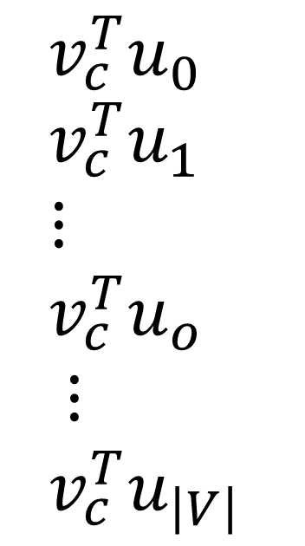
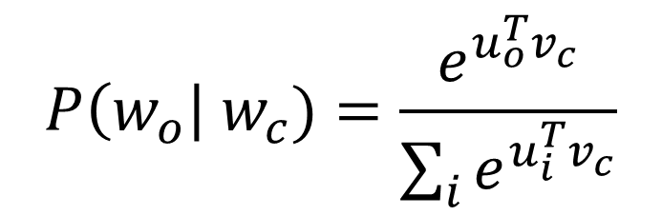
Word2Vec with Negative Sampling
$$v_{c}^{T}u_{0} \\ v_{c}^{T}u_{1} \\ ⋮ \\ v_{c}^{T}u_{o} \\ ⋮ \\ {v_{c}^{T}u}_{\left|V\right|}$$
Maximizing
$$P\left(w_{o}\right| w_{c})=\frac{e^{u_{o}^{T}v_{c}}}{\sum_{i}{e^{u_{i}^{T}v_{c}}}}$$

Slide 20
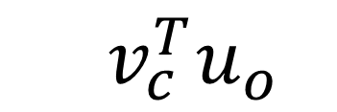
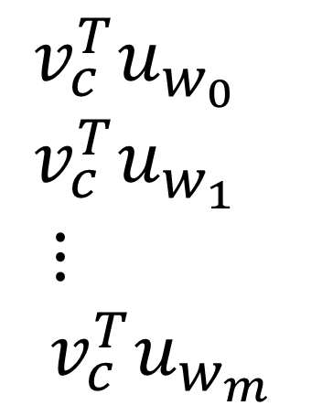
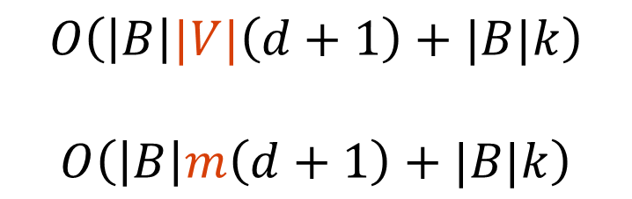
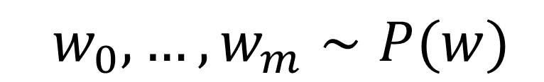
Word2Vec with Negative Sampling
Idea: Select a random set of negatives rather than all of them
Positive
Negatives
$$w_{0}, …, w_{m}∼P(w)$$
$$v_{c}^{T}u_{o}$$
$$v_{c}^{T}u_{w_{0}} \\ v_{c}^{T}u_{w_{1}} \\ ⋮ \\ {v_{c}^{T}u}_{w_{m}}$$
$$O\left(\left|B\right||V|\left(d+1\right)+|B|k\right)$$
$$O\left(\left|B\right|m\left(d+1\right)+|B|k\right)$$

Slide 21
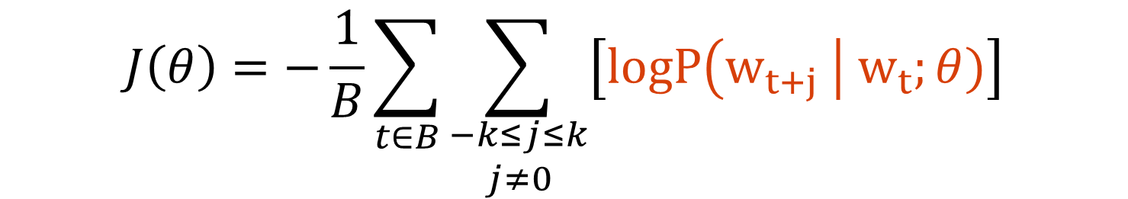
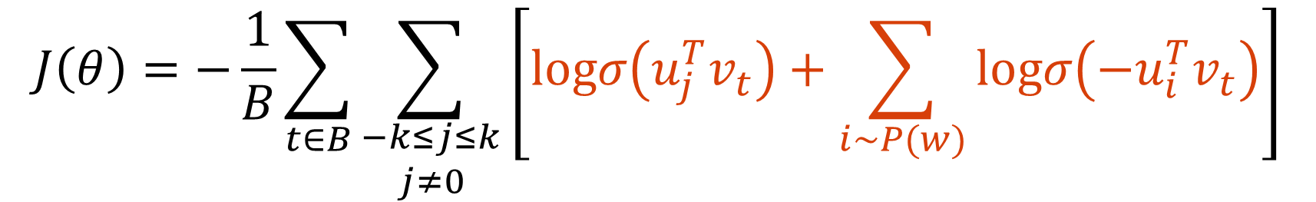
Word2Vec with Negative Sampling
$$J\left(θ\right)=−\frac{1}{B}\sum_{t∈B}{\sum_{\begin{aligned}−k≤j≤k \\ j≠0\end{aligned}}{\left[logP\left(w_{t+j} \right| w_{t};θ)\right]}}$$
$$J\left(θ\right)=−\frac{1}{B}\sum_{t∈B}{\sum_{\begin{aligned}−k≤j≤k \\ j≠0\end{aligned}}{\left[logσ\left(u_{j}^{T}v_{t}\right)+\sum_{i∼P(w)}{logσ\left(−u_{i}^{T}v_{t}\right)}\right]}}$$
Distributed Representations of Words and Phrases and their Compositionality (https://arxiv.org/pdf/1310.4546.pdf)

Slide 22
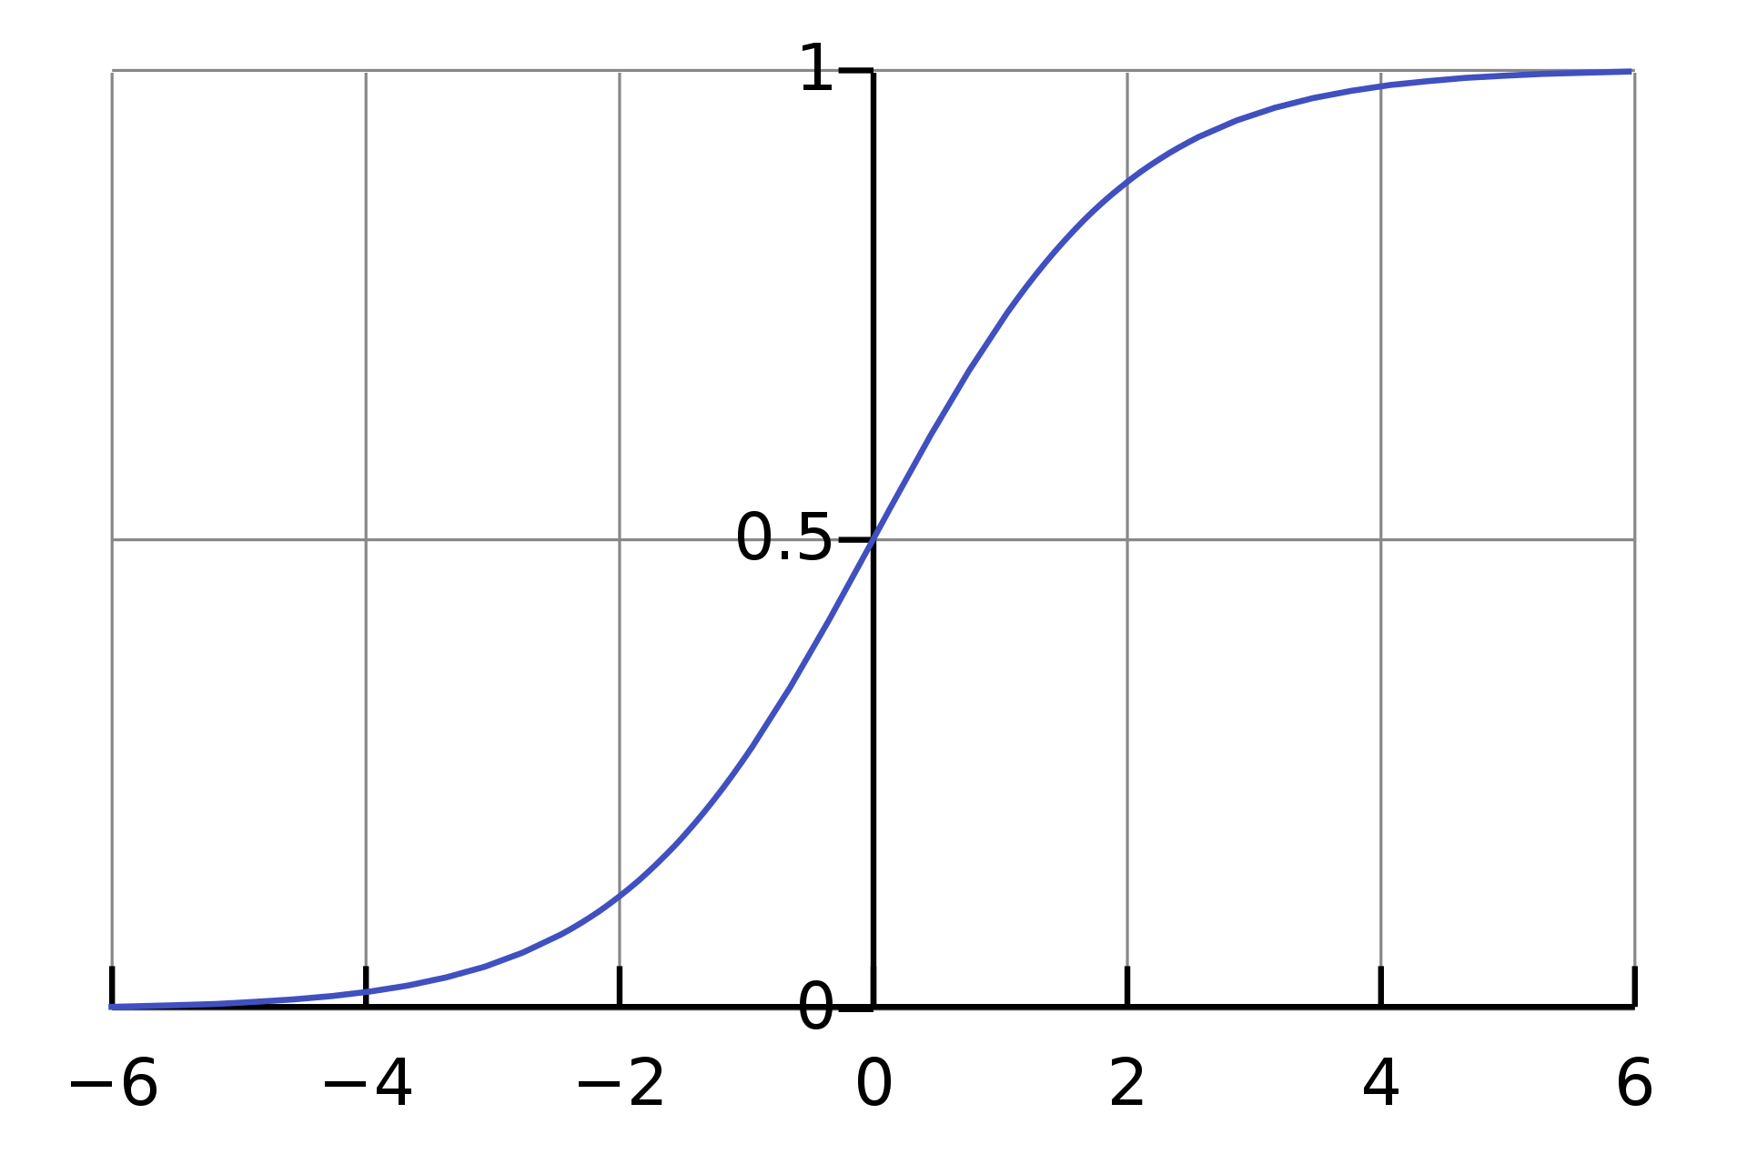

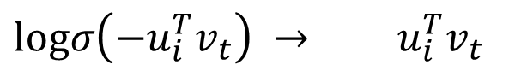
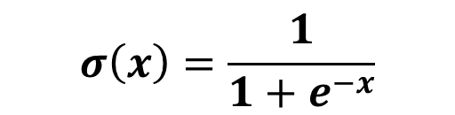
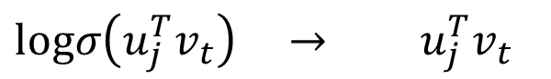
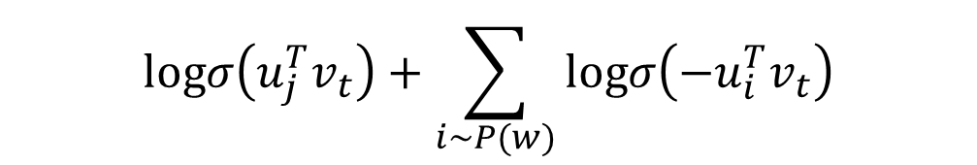

Word2Vec with Negative Sampling
$$J\left(θ\right)=−\frac{1}{B}\sum_{t∈B}{\sum_{\begin{aligned}−k≤j≤k \\ j≠0\end{aligned}}{\left[logσ\left(u_{j}^{T}v_{t}\right)+\sum_{i∼P(w)}{logσ\left(−u_{i}^{T}v_{t}\right)}\right]}}$$
$J\left(θ\right)$ implies:
Recall Logistic Function
$$logσ\left(u_{j}^{T}v_{t}\right)+\sum_{i∼P(w)}{logσ\left(−u_{i}^{T}v_{t}\right)}$$
$$σ\left(x\right)=\frac{1}{1+e^{−x}}$$
$logσ\left(u_{j}^{T}v_{t}\right) → u_{j}^{T}v_{t}$
$logσ\left(−u_{i}^{T}v_{t}\right) → u_{i}^{T}v_{t}$
Distributed Representations of Words and Phrases and their Compositionality (https://arxiv.org/pdf/1310.4546.pdf)

Slide 23
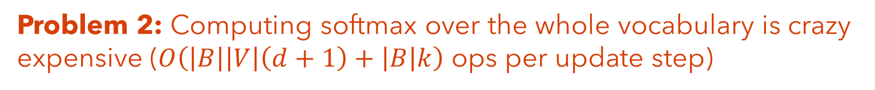
Word2Vec (AKA SkipGram with Negative Sampling SGNS)
Problem 1: Gradient descent requires iterating over whole corpus -- slow to converge and expensive
SGD: Approximate full gradient with a small, random subset of instances → fine in expectation
Problem 2: Computing softmax over the whole vocabulary is crazy expensive ($O\left(\left|B\right|\left|V\right|\left(d+1\right)+\left|B\right|k\right)$ ops per update step)
Randomly sample negatives words and adjust our loss → fine in expectation

Slide 24
Be able to answer:
How is word2vec optimized?
What is Stochastic Gradient Descent?
Why is the word2vec objective inefficient and how can this shortcoming be mitigated?
How are word vectors evaluated?
Describe intrinsic vs extrinsic evaluation in NLP
What are the dangers of learning from historic data and large corpuses?

Slide 25
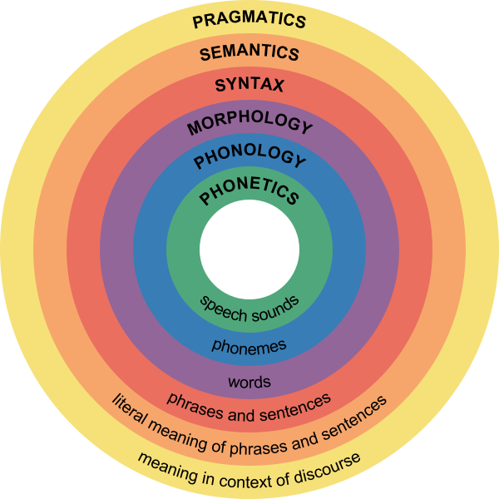
Evaluation in NLP
Intrinsic Evaluation – How well does an algorithm do the thing it was trained to do?
E.g., do word-vector similarities match human notions of similarity?
vocab
Extrinsic Evaluation – How useful is the result of an algorithm to other tasks in NLP?
E.g., does using word2vec embeddings improve text classification algorithms?
vocab

Slide 26
Intrinsic Evaluation of Word Vector Algorithms
Desired Properties of Word Vectors:
Capture Lexical Ambiguity – all senses of a word should be encoded e.g., “the bow of a ship” and “bow and arrows”
Capture Relationships – both semantic (synonymy / antonymy) and morphological (e.g. fast : faster :: slow : slower)
Low Variance – if I re-run the algorithm, how different are the results
Problem: How to measure these things?
Evaluating Word Embedding Models: Methods and Experimental Results (arxiv.org/pdf/1901.09785.pdf)

Slide 27
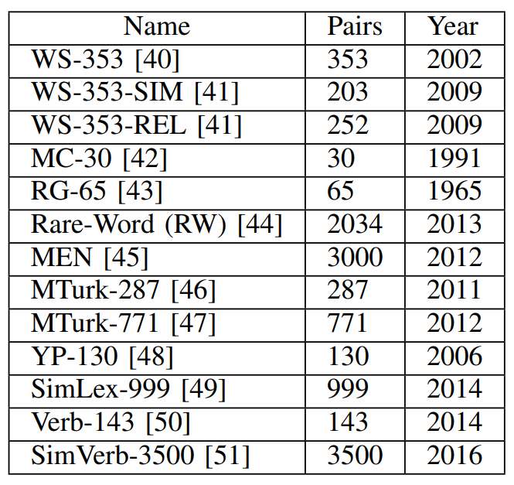
Intrinsic Evaluation of Word Vector Algorithms: Common Tasks
⚑
Word Similarity
Idea – get humans to rate a bunch of word pairs based on their similarity and then compare these to cosine similarities produced by word vectors.
Pair | Rating
exterminate / kill | 9.88
affordable / cheap | 8
championship / contest | 6.22
subroutines / software | 4.33
flatulence / physical | 3.2
demanded / cost | 1.12
Evaluating Word Embedding Models: Methods and Experimental Results (arxiv.org/pdf/1901.09785.pdf)

Slide 28
Rerank these word pairs based on similarity (higher rank = more similar):
nonpublic :: private
autoregulation :: organic
spherical :: round
microvolts :: potential
designed :: intend
circumvent :: beat
Example answer format: i, g, h, f, j

Slide 29
Rerank these word pairs based on similarity (higher rank = more similar):
nonpublic :: private
autoregulation :: organic b) spherical :: round (10/10)
spherical :: round a) autoregulation :: organic (7/10)
microvolts :: potential d) designed :: intend (5/10)
designed :: intend e) circumvent :: beat (4/10)
circumvent :: beat c) microvolts :: potential (1/10)
Example answer format: i, g, h, f, j

Slide 30
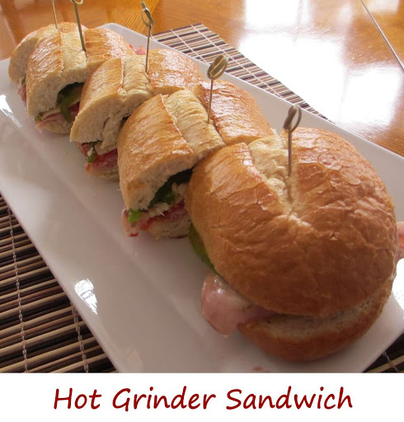
Intrinsic Evaluation of Word Vector Algorithms: Common Tasks
⚑
Word Similarity
Idea – get humans to rate a bunch of word pairs based on their similarity and then compare these to cosine similarities produced by word vectors.
Pair | Rating | StDev
exterminate / kill | 9.88 | 2.08
affordable / cheap | 8.22 | 1.62
championship / contest | 6.22 | 1.78
subroutines / software | 4.33 | 3.30
flatulence / physical | 3.2 | 3.00
demanded / cost | 1.12 | 2.70
nonnative / foreign | 10 | 0
grinder / sandwich | 9.3 | 4.71
cowboys / ranch | 7.33 | 3.95
7 0 8 9 0 7 0 10 8 5
Evaluating Word Embedding Models: Methods and Experimental Results (arxiv.org/pdf/1901.09785.pdf)

Slide 31
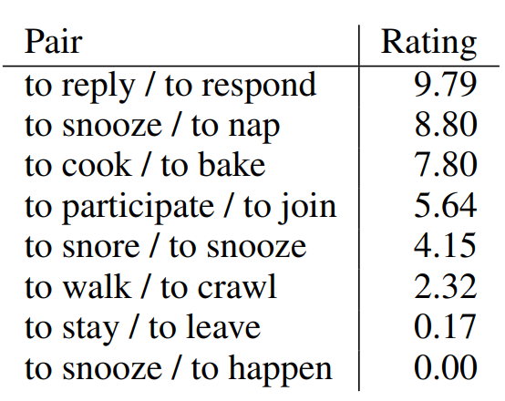
Intrinsic Evaluation of Word Vector Algorithms: Common Tasks
⚑
Word Similarity
Idea – get humans to rate a bunch of word pairs based on their similarity and then compare these to cosine similarities produced by word vectors.
Evaluating Word Embedding Models: Methods and Experimental Results (arxiv.org/pdf/1901.09785.pdf)

Slide 32

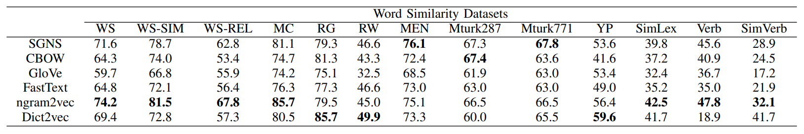
Intrinsic Evaluation of Word Vector Algorithms: Common Tasks
⚑
Word Similarity
Idea – get humans to rate a bunch of word pairs based on their similarity and then compare these to cosine similarities produced by word vectors.
word2vec we studied in class:
Report correlation between human and vector similarities.
(All trained on the same medium-sized corpus)
Evaluating Word Embedding Models: Methods and Experimental Results (arxiv.org/pdf/1901.09785.pdf)

Slide 33
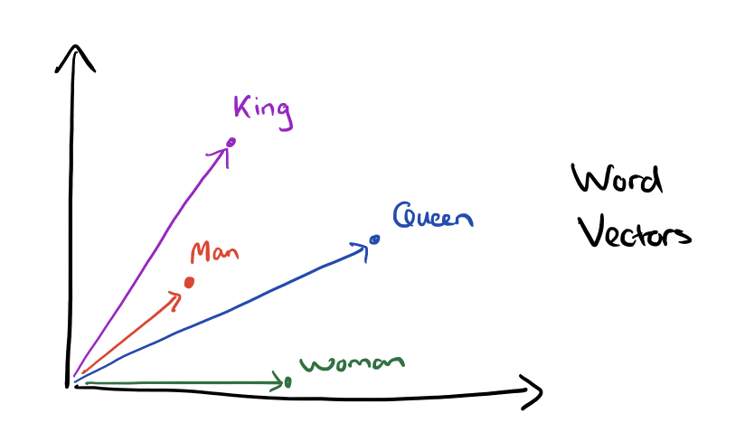
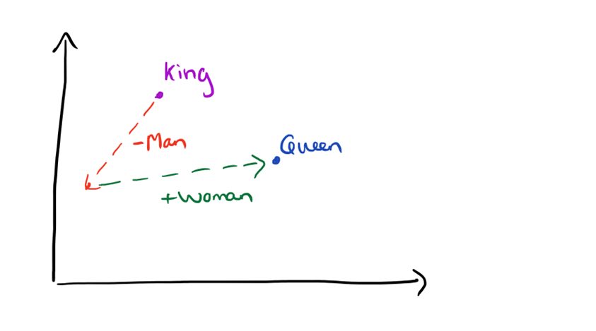
Intrinsic Evaluation of Word Vector Algorithms: Common Tasks
⚑
Word Analogies
Idea – collect a set of word analogy questions of the form “a is to b as c is to ?” or more compactly a : b :: c : ? and evaluate the model’s answer
$$d^{∗}=argmax_{d} cos(d, b−a+c)$$
man : king :: woman : ?
Graphic Credit: The amazing power of word vectors, Adrian Coyler

Slide 34
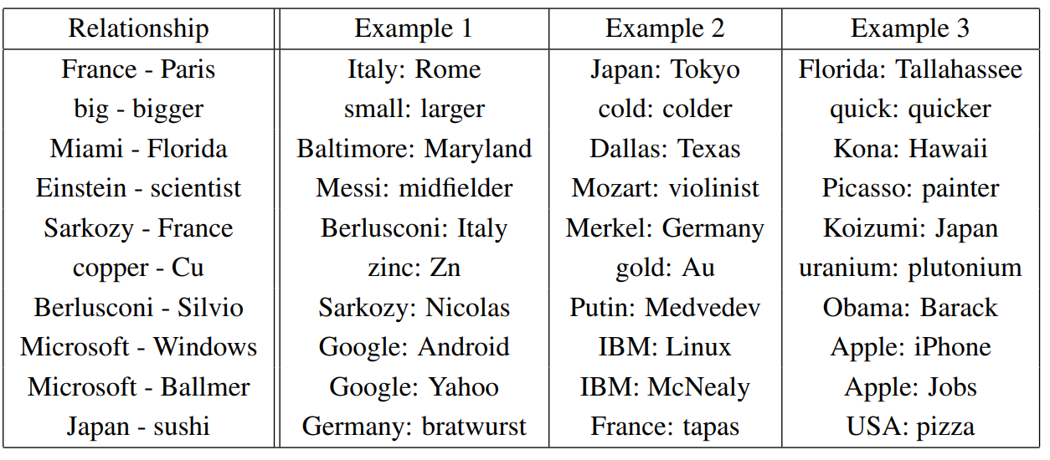
Intrinsic Evaluation of Word Vector Algorithms: Common Tasks
⚑
Word Analogies
Idea – collect a set of word analogy questions of the form “a is to b as c is to ?” or more compactly a : b :: c : ? and evaluate the model’s answer
b - a
+ c₁
+ c₂
+ c₃
Examples from word2vec paper
Efficient Estimation of Word Representations in Vector Space (https://arxiv.org/pdf/1301.3781.pdf)

Slide 35
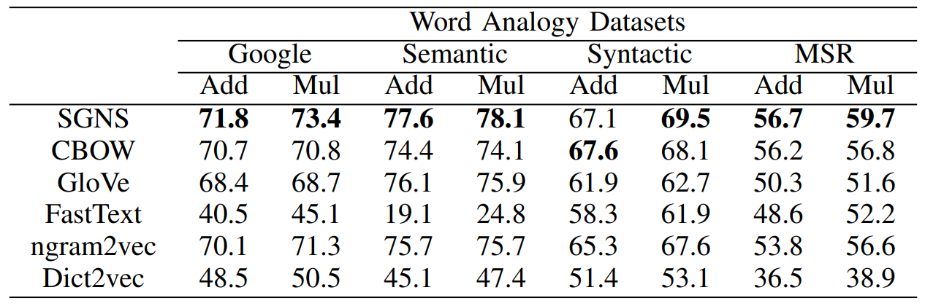
Intrinsic Evaluation of Word Vector Algorithms: Common Tasks
⚑
Word Analogies
Idea – collect a set of word analogy questions of the form “a is to b as c is to ?” or more compactly a : b :: c : ? and evaluate the model’s answer
Evaluating Word Embedding Models: Methods and Experimental Results (arxiv.org/pdf/1901.09785.pdf)

Slide 36
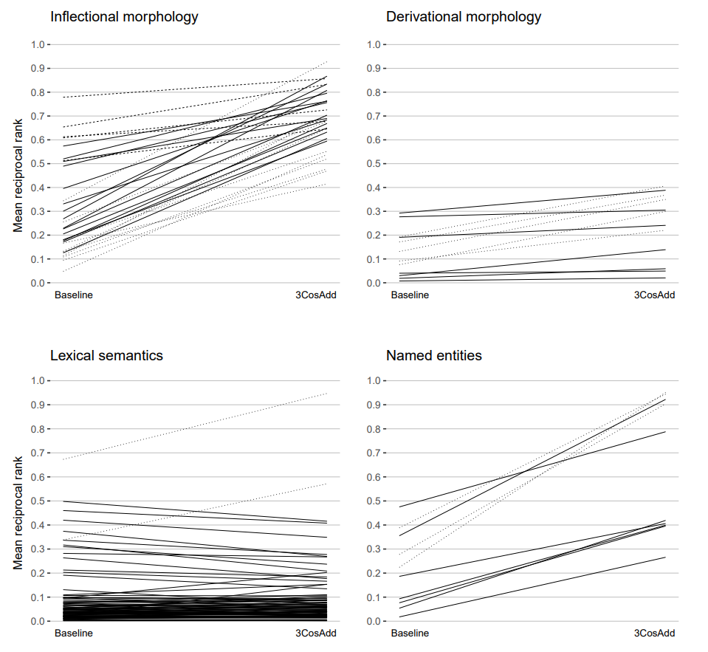
Intrinsic Evaluation of Word Vector Algorithms: Common Tasks
⚑
Word Analogies
Idea – collect a set of word analogy questions of the form “a is to b as c is to ?” or more compactly a : b :: c : ? and evaluate the model’s answer
gender analogies
cow : cows :: dog : dogs Change count / tense
beauty : beautiful :: joy : joyful Change grammatic function of word
banana : yellow :: sky : blue
Relates to semantic concepts
Tokyo : Japan :: London : UK
Test knowledge about proper nouns
Don’t get too excited: some studies suggest most of this may come from similarity of the vectors already (i.e. d was already closest to c ignoring a/b). Controlling for this baseline – somewhat poor at semantics.
What Analogies Reveal about Word Vectors and their Compositionality (www.aclweb.org/anthology/S17-1001.pdf)

Slide 37
Intrinsic Evaluation of Word Vector Algorithms: Common Tasks
⚑
Word Analogies
Idea – collect a set of word analogy questions of the form “a is to b as c is to ?” or more compactly a : b :: c : ? and evaluate the model’s answer
Don’t get too excited: some studies suggest most of this may come from similarity of the vectors already (i.e. d was already closest to c ignoring a/b). Controlling for this baseline – somewhat poor at semantics.
What Analogies Reveal about Word Vectors and their Compositionality (www.aclweb.org/anthology/S17-1001.pdf)

Slide 38
Intrinsic Evaluation of Word Vector Algorithms: Common Tasks
⚑
Word Analogies
Idea – collect a set of word analogy questions of the form “a is to b as c is to ?” or more compactly a : b :: c : ? and evaluate the model’s answer
cow : cows :: dog : dogs Change count / tense
Don’t get too excited: some studies suggest most of this may come from similarity of the vectors already (i.e. d was already closest to c ignoring a/b). Controlling for this baseline – somewhat poor at semantics.
What Analogies Reveal about Word Vectors and their Compositionality (www.aclweb.org/anthology/S17-1001.pdf)

Slide 39
Intrinsic Evaluation of Word Vector Algorithms: Common Tasks
⚑
Word Analogies
Idea – collect a set of word analogy questions of the form “a is to b as c is to ?” or more compactly a : b :: c : ? and evaluate the model’s answer
cow : cows :: dog : dogs Change count / tense
beauty : beautiful :: joy : joyful Change grammatic function of word
Don’t get too excited: some studies suggest most of this may come from similarity of the vectors already (i.e. d was already closest to c ignoring a/b). Controlling for this baseline – somewhat poor at semantics.
What Analogies Reveal about Word Vectors and their Compositionality (www.aclweb.org/anthology/S17-1001.pdf)

Slide 40
Intrinsic Evaluation of Word Vector Algorithms: Common Tasks
⚑
Word Analogies
Idea – collect a set of word analogy questions of the form “a is to b as c is to ?” or more compactly a : b :: c : ? and evaluate the model’s answer
gender analogies
cow : cows :: dog : dogs Change count / tense
beauty : beautiful :: joy : joyful Change grammatic function of word
banana : yellow :: sky : blue
Relates to semantic concepts
Don’t get too excited: some studies suggest most of this may come from similarity of the vectors already (i.e. d was already closest to c ignoring a/b). Controlling for this baseline – somewhat poor at semantics.
What Analogies Reveal about Word Vectors and their Compositionality (www.aclweb.org/anthology/S17-1001.pdf)

Slide 41
Intrinsic Evaluation of Word Vector Algorithms: Common Tasks
⚑
Word Analogies
Idea – collect a set of word analogy questions of the form “a is to b as c is to ?” or more compactly a : b :: c : ? and evaluate the model’s answer
gender analogies
cow : cows :: dog : dogs Change count / tense
beauty : beautiful :: joy : joyful Change grammatic function of word
banana : yellow :: sky : blue
Relates to semantic concepts
Tokyo : Japan :: London : UK
Test knowledge about proper nouns
Don’t get too excited: some studies suggest most of this may come from similarity of the vectors already (i.e. d was already closest to c ignoring a/b). Controlling for this baseline – somewhat poor at semantics.
What Analogies Reveal about Word Vectors and their Compositionality (www.aclweb.org/anthology/S17-1001.pdf)

Slide 42
Intrinsic Evaluation of Word Vector Algorithms: Common Tasks
⚑
Concept Clustering / Outlier Detection
Idea – group words by some high-level concept and then see if word vectors correctly identify the groups (or outliers in the groups)
Concept Clustering:
GT: {shirt, shorts, shoes, hat, socks} {soap, bath, clean} {peanut, walnut}
K-means: {shirt, shorts, hat} {shoes, socks} {soap, bath, clean} {peanut, walnut}
Outlier Detection:
Easy example: shirt, shorts, shoes, hat, soap, socks
Hard example: apple, pear, walnut, hazelnut, fig, peanut
Evaluating Word Embedding Models: Methods and Experimental Results (arxiv.org/pdf/1901.09785.pdf)

Slide 43
Evaluation in NLP
Intrinsic Evaluation – How well does an algorithm do the thing it was trained to do? For word vectors:
vocab
⚑
Word Similarity
⚑
Word Analogies
⚑
Category Clustering / Outlier Detection
Pessimistic Summary: Define geometric operations on word vectors that seem meaningful sometimes and see how well they match noisy human answers to TOEFL questions.

Slide 44
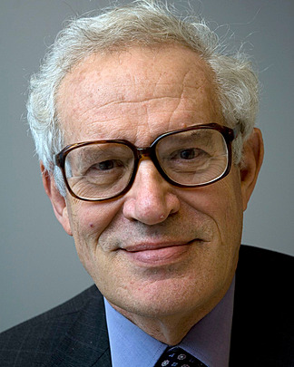
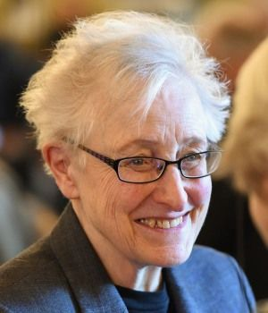
A Warning from Goodhart’s Law
"When a measure becomes a target,
it ceases to be a good measure.”
- Goodhart’s Law as written by Marilyn Strathern
Originally stated as “Any observed statistical regularity will tend to collapse once pressure is placed upon it for control purposes” in the context of economics. Later generalized to the above by anthropologist Marilyn Strathern.
Charles Goodhart
Do we care about word similarity tasks? Analogies? Finding odd-one-outs? Should we be excited if a paper comes around that improves these?
Maybe, but maybe not. The point of these tasks was to investigate the word embeddings – i.e., to act as a measure, not a target. Limited faith that optimizing for these will yield good word vectors.

Slide 45
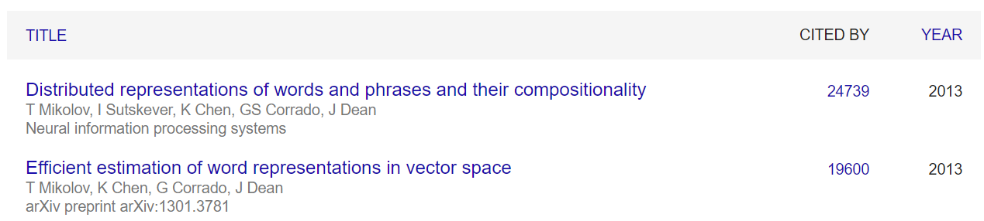

Evaluation in NLP
vocab
Extrinsic Evaluation – How useful is the result of an algorithm to other downstream tasks in NLP?
Learning-based word vectors have had a HUGE impact and were / are widely used:

Slide 46
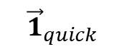

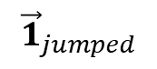
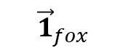
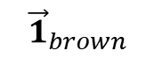
Evaluation in NLP
vocab
Extrinsic Evaluation – How useful is the result of an algorithm to other downstream tasks in NLP?
A quick brown fox jumped.
$${\vec{1}}_{a}$$
$${\vec{1}}_{quick}$$
$${\vec{1}}_{brown}$$
$${\vec{1}}_{fox}$$
$${\vec{1}}_{jumped}$$
Task-Specific
Machine Learning Algorithm
Output / Loss

Slide 47





Evaluation in NLP
vocab
Extrinsic Evaluation – How useful is the result of an algorithm to other downstream tasks in NLP?
A quick brown fox jumped.
$${\vec{w}}_{a}$$
$${\vec{w}}_{quick}$$
$${\vec{w}}_{brown}$$
$${\vec{w}}_{fox}$$
$${\vec{w}}_{jumped}$$
word2vec
Task-Specific
Machine Learning Algorithm
Output / Loss

Slide 48
Extrinsic Evaluation of Word Vector Algorithms: Some Downstream Tasks
Word vectors have been used in practically every NLP task, subset from [1]:
⚑
Part-of-Speech Tagging
⚑
Sentiment Analysis
⚑
Machine Translation
Note: These are whole areas of study in their own rights. We are visiting briefly but will return.
[1] Evaluating Word Embedding Models: Methods and Experimental Results (arxiv.org/pdf/1901.09785.pdf)

Slide 49
Extrinsic Evaluation of Word Vector Algorithms: Some Downstream Tasks
⚑
Part-of-Speech Tagging
Predict the part of speech for each word in a text
Many, many more parts of speech than you learned in school
Sent. | POS |  | POS Explanation
I | PRON | PRP | Pronoun, personal
like | VERB | VBP | Verb, non-3rd person singular present
to | PART | TO | Infinitival to
play | VERB | VB | Verb, base form
soccer | noun | NN | Noun, singular or mass
[1] Evaluating Word Embedding Models: Methods and Experimental Results (arxiv.org/pdf/1901.09785.pdf)

Slide 50
Extrinsic Evaluation of Word Vector Algorithms: Some Downstream Tasks
⚑
Sentiment Analysis
Given a bit of text, predict the affective state of the writer
E.g., polarity - positive or negative opinion being expressed
The movie is surprising with plenty of unsettling plot twists. (+)
I just love having to wait two hours for my food. ( - )
I’m a big fan of RPGs in general, but this one just wasn’t for me. ( - )
Super fun class but I didn’t learn anything from the lectures. ( ? )
[1] Evaluating Word Embedding Models: Methods and Experimental Results (arxiv.org/pdf/1901.09785.pdf)

Slide 51
Extrinsic Evaluation of Word Vector Algorithms: Some Downstream Tasks
⚑
Machine Translation
Given text in a source language, produce semantically identical text in a target language.
To my surprise, the computer can translate well
令我惊讶的是，计算机可以很好地翻译
मेरे आश्चर्य के लिए, कंप्यूटर अच्छी तरह से अनुवाद कर सकता है।
Para mi sorpresa, la computadora puede traducir bien
[1] Evaluating Word Embedding Models: Methods and Experimental Results (arxiv.org/pdf/1901.09785.pdf)

Slide 52

Relationship between Intrinsic and Extrinsic Evaluations of Word Vectors
Sentiment
POS
Translation
[1] measure correlation between intrinsic task performance and extrinsic task performance.
Results are inconsistent across tasks and even datasets in a task
Word Similarity
Analogies
Context Categorization
Outlier Detection
[1] Evaluating Word Embedding Models: Methods and Experimental Results (arxiv.org/pdf/1901.09785.pdf)

Slide 53
Be able to answer:
How is word2vec optimized?
What is Stochastic Gradient Descent?
Why is the word2vec objective inefficient and how can this shortcoming be mitigated?
How are word vectors evaluated?
Describe intrinsic vs extrinsic evaluation in NLP
What are the dangers of learning from historic data and large corpuses?

Slide 54

A Brief Preface on Ethics in NLP
Us
Commercial NLP

Slide 55
A Brief Preface on Ethics in NLP
Why Talk About Ethics in NLP?
The box is open. NLP works well enough to be profitable. No shutting it now.
The things we build or refuse to build will impact real people’s lives.
How we build them will affect whether that impact is positive or negative.
Us
Commercial NLP
Recommend Dan Jurafsky’s Course on NLP Ethics: https://web.stanford.edu/class/cs384/

Slide 56









Dangers of Learning from a Large, Historical Corpus
$$\begin{matrix}w_{aardvark} \\ \begin{aligned}⋮ \\ ⋮\end{aligned} \\ w_{zebra}\end{matrix}$$
Huge Pile of Text
word2vec
Machine Learning
Downstream Task

Slide 57


Dangers of Learning from a Large, Historical Corpus
$$\begin{matrix}w_{aardvark} \\ \begin{aligned}⋮ \\ ⋮\end{aligned} \\ w_{zebra}\end{matrix}$$
or
Huge Pile of Text
word2vec
Machine Learning
Downstream Task
If the corpus contains undesirable associations, what happens to this chain?
Focus on gender bias as an example, but broad problem.

Slide 58

Gender Bias in Word Embeddings
More Gender Neutral
More
Female
Associated word2vec
More
Male
Associated
word2vec
More Gendered
Early analysis found significant gender bias in non-gendered words.
Man is to Computer Programmer as Woman is to Homemaker? Debiasing Word Embeddings (https://arxiv.org/pdf/1607.06520.pdf)

Slide 59










Measuring Gender Bias in Word Embeddings
Try to find a gender subspace. (I.e., a set of dimensions that encode normative gender roles)
i) Pick a set of common, oppositely gendered words and take their difference
$$\vec{she} −\vec{he}$$
$$\vec{gal} −\vec{guy}$$
$$\vec{girl} −\vec{boy}$$
$$\vec{herself} −\vec{himself}$$
$$\vec{woman} −\vec{man}$$
$$\vec{Mary} −\vec{John}$$
$$\vec{her} −\vec{his}$$
$$\vec{female} −\vec{male}$$
$$\vec{daughter} −\vec{son}$$
$$\vec{mother} −\vec{father}$$
ii) Perform PCA and take the top component as a “gender” direction
Project query words onto this dimension to measure gender-association.
Man is to Computer Programmer as Woman is to Homemaker? Debiasing Word Embeddings (https://arxiv.org/pdf/1607.06520.pdf)

Slide 60

Gender Bias in Word Embeddings
Newer work refines this but still finds substantial bias
amplification in gendered or gender-stereotyped words.
Understanding Undesirable Word Embedding Associations (https://www.aclweb.org/anthology/P19-1166.pdf)

Slide 61
Gender Bias in Word Embeddings
Good news: Strong approaches to debias word vectors given sets of words defining the subspace on which the bias manifests. [1]
- e.g., making words equidistant along a gender subspace
Bad news: You need to manually define those subspaces. → We must find (or hypothesis) bias before we can correct it.
Worse news: Underlying structure between words are likely still biased even if debiased on the subspace. [2] - e.g., receptionist is still closer to softball than football
Even Worse news: The community has moved on to more complicated models that are less well understood – but still consume large corpuses.
[1] Understanding Undesirable Word Embedding Associations (https://www.aclweb.org/anthology/P19-1166.pdf)
[2] Lipstick on a Pig: Debiasing Methods Cover up Systematic Gender Biases in Word Embeddings But do not Remove Them
(https://www.aclweb.org/anthology/N19-1061.pdf)

Slide 62

Example from Machine Translation
Turkish isn’t a gendered language

Slide 63

Example from Machine Translation
Maybe good news: Companies do appear to be trying (once academics and media calls them out)

Slide 64


End on a Positive Thought – We can use this to examine text bias!
Idea: Train word embeddings on each decade of Corpus of Historical American English (COHA)
Word embeddings quantify 100 years of gender and ethnic stereotypes (https://www.pnas.org/content/pnas/115/16/E3635.full.pdf)

Slide 65

End on a Positive Thought – We can use this to examine text bias!
Idea: Train word embeddings on each decade of Corpus of Historical American English (COHA)
Word embeddings quantify 100 years of gender and ethnic stereotypes (https://www.pnas.org/content/pnas/115/16/E3635.full.pdf)

Slide 66
Be able to answer:
How is word2vec optimized?
What is Stochastic Gradient Descent?
Why is the word2vec objective inefficient and how can this shortcoming be mitigated?
How are word vectors evaluated?
Describe intrinsic vs extrinsic evaluation in NLP
What are the dangers of learning from historic data and large corpuses?

Slide 67
Next time
Next Time: Mostly math as we dive into deep learning. Perceptron, fully connected networks, and computational graphs!

